Slide 1
HW1 - TTS
Team 5 B09901116 陳守仁、B09602017 白宗民、B08901207 呂俐君

Slide 2
Outline
Text Processed into Model Input
Number
Cleaners
Languages
Pre-processing of Original Audio Files
Training
Input Formats
Loss
Duration
Generating Speed

Slide 3
Basic Experiments

Slide 4
Q1. 文字如何被處理成模型輸入?
Numbers
Removing Commas: "2,500" becomes "2500".
Expanding Decimal Points: "3.14" becomes "three point one four".
Expanding Currency Formats:
Pounds: "£500" becomes "five hundred pounds".
Dollars: "$20.50" becomes "twenty dollars, fifty cents".
Expanding Ordinals: "1st" becomes "first", "22nd" becomes "twenty-second".
General Number Expansion:
Numbers like "2019" might be read as "two thousand nineteen".
Larger numbers like "12345" become "twelve thousand three hundred forty-five".

Slide 5
Text Processed into Model Input - Number
 | Input | Output
Removing Commas | 2,500 | "2500"
Expanding Decimal Points | 3.14 | Three point one four
Expanding Currency Formats | £500 $20.50 | five hundred pounds twenty dollars, fifty cents
Expanding Ordinals | 1st / 22nd | First / twenty-second
General Number Expansion | 2019 12345 | two thousand nineteen twelve thousand three hundred forty-five

Slide 6
Q1. 文字如何被處理成模型輸入?
Cleaners
Basic Cleaners:
Input: "Hello WORLD " →Output: "hello world"
Number Expansion: "I have 2 dogs" becomes "I have two dogs".
Abbreviation Expansion: "Dr. Smith" becomes "doctor smith".
Transliteration Cleaners (for non-English text):
Input: "こんにちは" (Japanese for "Hello")
Output: "konnichiwa" (ASCII transliteration)

Slide 7
Text Processed into Model Input - Cleaners
Basic Cleaners | Input | Output
Uppercase → lowercase | HELLO WORLD | Hello world
Number Expansion | I have 2 dogs | I have two dogs
Abbreviation Expansion | Dr. Smith | doctor smith
Transliteration Cleaners | Input | Output
(for non-English text) | for "Hello" | ASCII transliteration
Japanese | こんにちは | konnichiwa

Slide 8
Q1. 文字如何被處理成模型輸入? - Text Processing
English Text Preprocessing:
Input: "Deep learning is fun."
Phonetic Representation: This input might be converted to a sequence like "{d}{iy}{p} {l}{iy}{r}{n}{ih}{ng} {ih}{z} {f}{ah}{n}"
Tokenized Sequence: This phonetic representation is then converted into a sequence of numerical tokens that the model can process.
Mandarin Text Preprocessing:
Input: "機器學習很有趣"
Pinyin Conversion: The text is converted into Pinyin, e.g., "jī qì xué xí hěn yǒu qù".
Phonetic Representation: This Pinyin is further converted to a phonetic sequence, possibly using a lexicon.
Tokenized Sequence: Similar to the English preprocessing, this phonetic representation is converted into a sequence of tokens for the TTS model.

Slide 9
Q1. 文字如何被處理成模型輸入? - Text Processing
English Text Preprocessing:
Input: "Deep learning is fun."
Phonetic Representation: This input might be converted to a sequence like "{d}{iy}{p} {l}{iy}{r}{n}{ih}{ng} {ih}{z} {f}{ah}{n}"
Tokenized Sequence: This phonetic representation is then converted into a sequence of numerical tokens that the model can process.
Mandarin Text Preprocessing:
Input: "機器學習很有趣"
Pinyin Conversion: The text is converted into Pinyin, e.g., "jī qì xué xí hěn yǒu qù".
Phonetic Representation: This Pinyin is further converted to a phonetic sequence, possibly using a lexicon.
Tokenized Sequence: Similar to the English preprocessing, this phonetic representation is converted into a sequence of tokens for the TTS model.

Slide 10
Text Processed into Model Input - English
Input: "Deep learning is fun."
Phonetic Representation: "{d}{iy}{p} {l}{iy}{r}{n}{ih}{ng} {ih}{z} {f}{ah}{n}"
Tokenized Sequence: This phonetic representation is then converted into a sequence of numerical tokens that the model can process.

Slide 11
Text Processed into Model Input - Mandarin
Input: "機器學習很有趣"
Pinyin Conversion: "jī qì xué xí hěn yǒu qù".
Phonetic Representation: This Pinyin is further converted to a phonetic sequence, possibly using a lexicon.
Tokenized Sequence: Similar to the English preprocessing, this phonetic representation is converted into a sequence of tokens for the TTS model.

Slide 12
Pre-processing of Original Audio Files
取出原始音檔的
mel spectrogram
Energy
pitch contour
duration

Slide 13
Input Formats
Tacotron2:
Characters
Mel Spectrogram
FastSpeech2:
Phonemes
Mel Spectrogram
Energy
Pitch contour
Duration

Slide 14
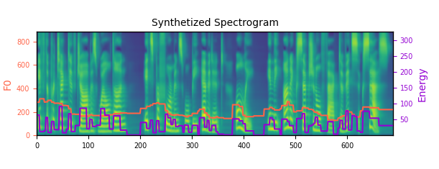
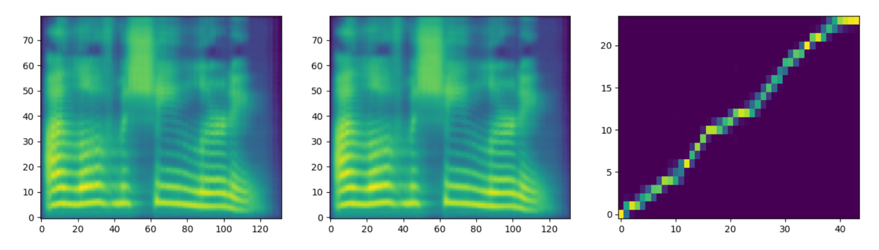

Slide 15
Loss of TTS Models
Tacotron2
Total Loss
Mel Loss
Gate Loss
FastSpeech2
Total Loss
Mel Loss
Mel-Postnet Loss
Pitch Loss
Energy Loss
Duration Loss
Notes:
Tacotron need to evaluate period – Gate loss (when to stop)
Autoregressive → need to evaluate when to stop

Slide 16
Training Duration
Tacotron2:
25 Hours
Fast Speech2:
LJSpeech ~4hrs
AISHELL ~4.5hrs

Slide 17
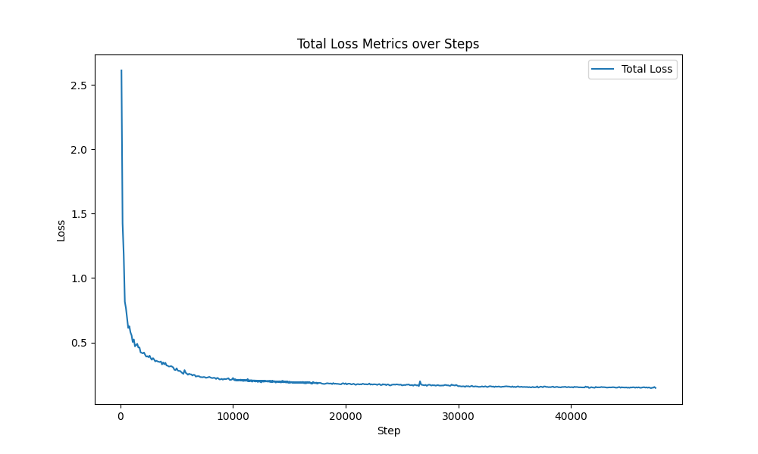
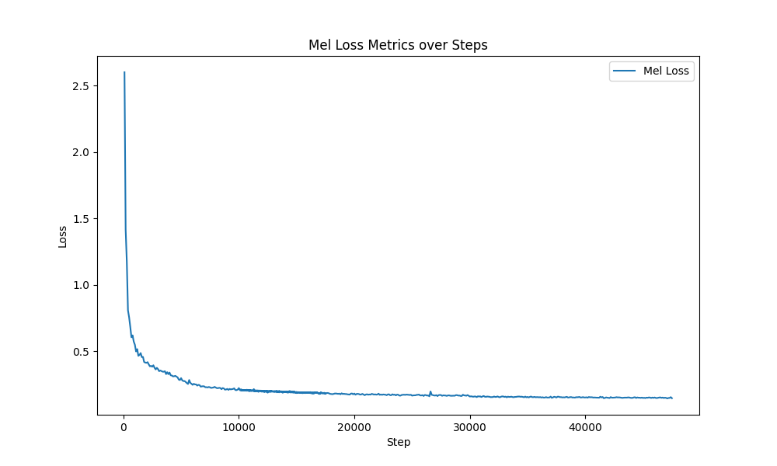
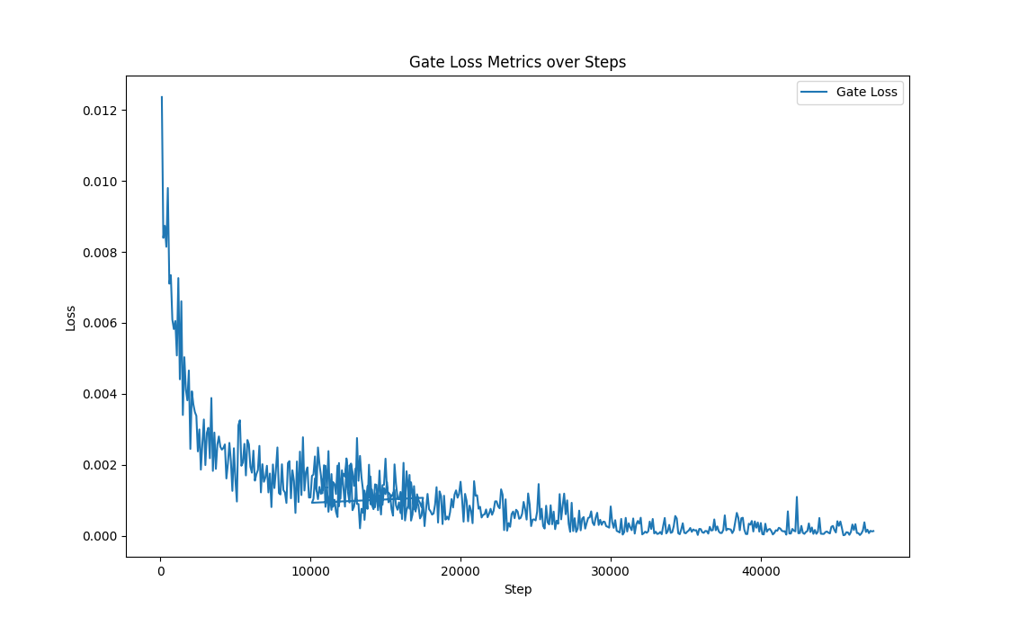
Tacotron Train on LJSpeech
Total Loss
MEL Loss
Gate Loss

Slide 18
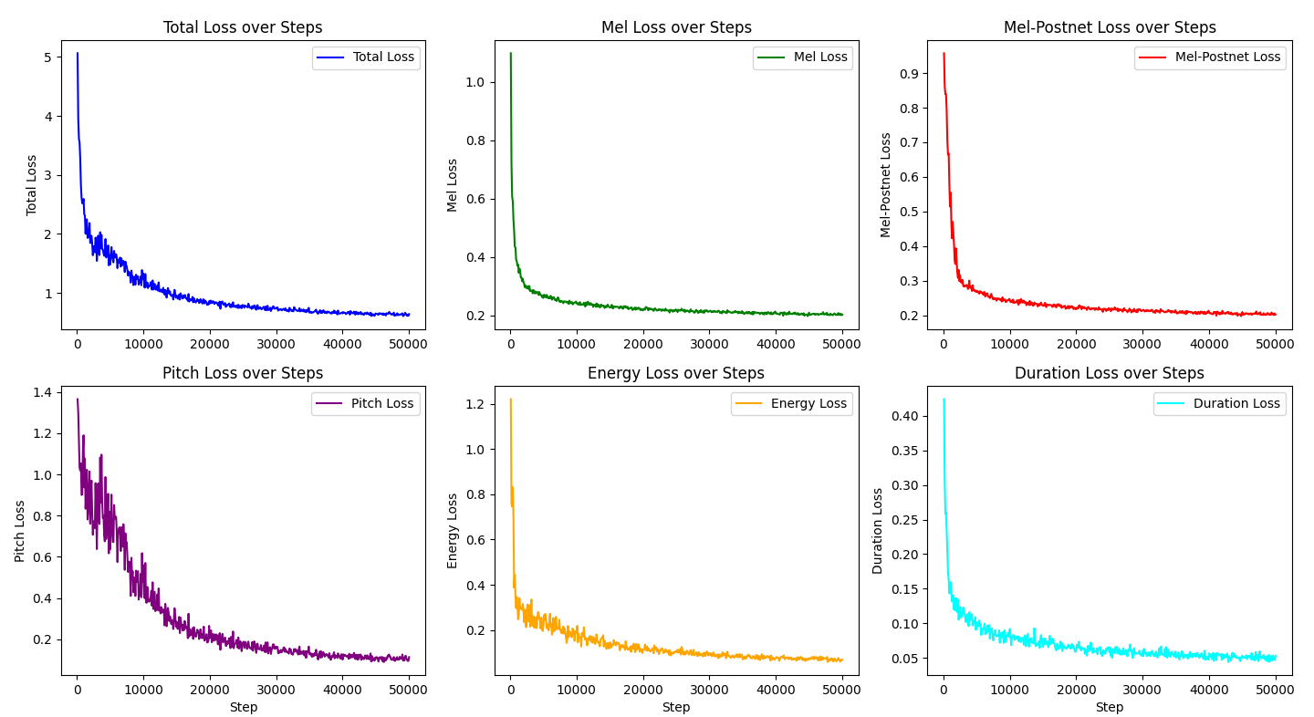
FastSpeech2 Train on LJSpeech

Slide 19
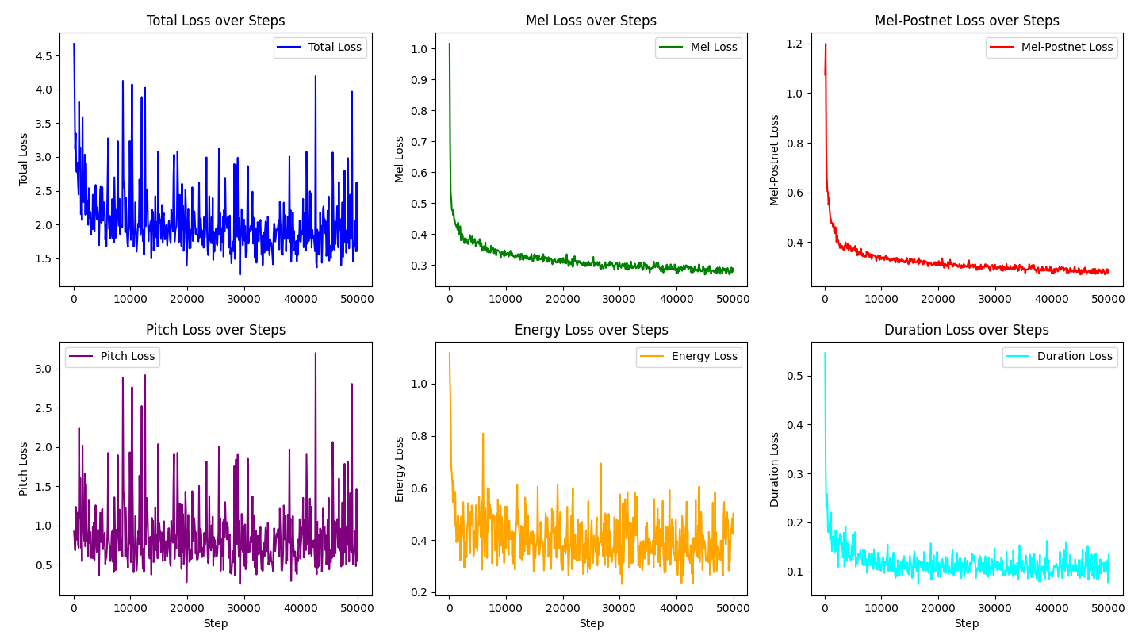
FastSpeech2 Train on AISHELL

Slide 20

Generating Speed
Model | Dataset | 音檔長度(sec) | 生成時間(sec)
FastSpeech | LJSpeech | 1 | 10.98
FastSpeech | AISHELL | 1 | 8.7
Tacotron | LJSpeech | 2 | 8.98

Slide 21
Tongue Twisters
Tongue Twister 1:
Tongue Twister 2:

Slide 22
Q8. Demo (好的例子/生壞的例子/缺點是甚麼)

Slide 23
Thanks!

